Slide 1
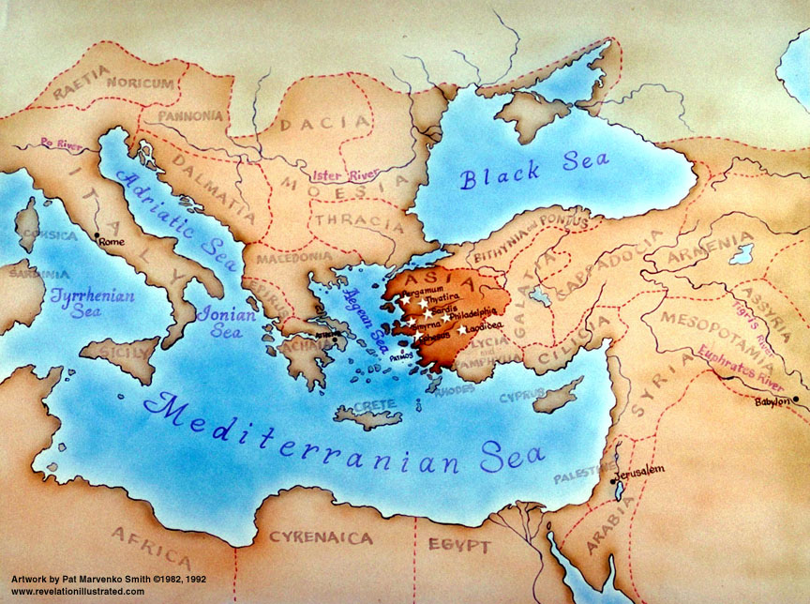
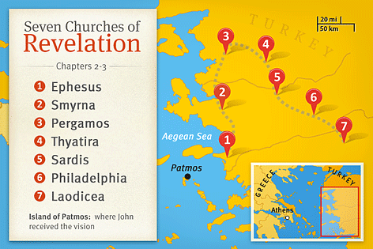

Slide 2
Matthew 24 : 32 - 51

Slide 3
³² “From the fig tree learn its lesson: as soon as its branch becomes tender and puts out its leaves, you know that summer is near. ³³ So also, when you see all these things, you know that he is near, at the very gates. ³⁴ Truly, I say to you, this generation will not pass away until all these things take place. ³⁵ Heaven and earth will pass away, but my words will not pass away.

Slide 4
³⁶ “But concerning that day and hour no one knows, not even the angels of heaven, nor the Son, but the Father only. ³⁷ For as were the days of Noah, so will be the coming of the Son of Man. ³⁸ For as in those days before the flood they were eating and drinking, marrying and giving in marriage, until the day when Noah entered the ark, ³⁹ and they were unaware until the flood came and swept them all away, so will be the coming of the Son of Man. ⁴⁰ Then two men will be in the field; one will be taken and one left.

Slide 5
⁴¹ Two women will be grinding at the mill; one will be taken and one left. ⁴² Therefore, stay awake, for you do not know on what day your Lord is coming. ⁴³ But know this, that if the master of the house had known in what part of the night the thief was coming, he would have stayed awake and would not have let his house be broken into. ⁴⁴ Therefore you also must be ready, for the Son of Man is coming at an hour you do not expect.

Slide 6
⁴⁵ “Who then is the faithful and wise servant, whom his master has set over his household, to give them their food at the proper time? ⁴⁶ Blessed is that servant whom his master will find so doing when he comes. ⁴⁷ Truly, I say to you, he will set him over all his possessions. ⁴⁸ But if that wicked servant says to himself, ‘My master is delayed,’ ⁴⁹ and begins to beat his fellow servants and eats and drinks with drunkards, ⁵⁰ the master of that servant will come on a day when he does not expect him and at an hour he does not know ⁵¹ and will cut him in pieces and put him with the hypocrites. In that place there will be weeping and gnashing of teeth.

Slide 7
Revelation 3:1-6

Slide 8
3 “And to the angel of the church in Sardis write: ‘The words of him who has the seven spirits of God and the seven stars.
“ ‘I know your works. You have the reputation of being alive, but you are dead. ² Wake up, and strengthen what remains and is about to die, for I have not found your works complete in the sight of my God. ³ Remember, then, what you received and heard. Keep it, and repent. If you will not wake up, I will come like a thief, and you will not know at what hour I will come against you.

Slide 9
⁴ Yet you have still a few names in Sardis, people who have not soiled their garments, and they will walk with me in white, for they are worthy. ⁵ The one who conquers will be clothed thus in white garments, and I will never blot his name out of the book of life. I will confess his name before my Father and before his angels. ⁶ He who has an ear, let him hear what the Spirit says to the churches.’

Slide 10
The Church at Sardis – Wake up or die...
Jesus is the source of power / light / life for a church
The only good thing about the church in Sardis is its reputation, but even that is false...
A name of being alive, but you are dead!!!
How can we tell if a church is alive???
By its reputation?
Do we assess our experience of how it “feels”?
Moving music
Upbeat
Good to listen to
It engages my emotions / spirit
Do we assume the biggest church has grown because it’s alive
Do we assess it by the programs it offers?
The lure of palatability and marketability of a church
How a church tastes – “Is it easy to swallow” – the easy road
How a church ‘sells itself’ – all about image
May lead to growth and the name of being alive

Slide 11
The Church at Sardis – Wake up or die...
Jesus is the source of power / light / life for a church
The only good thing about the church in Sardis is its reputation, but even that is false...
A name of being alive, but you are dead!!!
A name/Reputation/appearance/feeling of being alive, but spiritually dead
Jesus looks for something different as evidence of an alive church
Holding to the basics of the Gospel – the narrow, hard road
Living with an expectation of the immanent return of Jesus (Righteous living & the urgency of preaching the Gospel)
Not soiling our ‘spiritual clothes’ – not living by the world’s values
Confessing Jesus Christ, without fear of offending
For a dead church to live again:
Wake up; Remember; Obey; Repent
Go back to basics of the Gospel.
If they don’t repent, the church will die.

Slide 12
⁴ Yet you have still a few names in Sardis, people who have not soiled their garments, and they will walk with me in white, for they are worthy. ⁵ The one who conquers will be clothed thus in white garments, and I will never blot his name out of the book of life. I will confess his name before my Father and before his angels. ⁶ He who has an ear, let him hear what the Spirit says to the churches.’

Slide 13
The Church at Sardis – Wake up or die...
Jesus is the source of power / light / life for a church
The only good thing about the church in Sardis is its reputation, but even that is false...
A name of being alive, but you are dead!!!
A name/Reputation/appearance/feeling of being alive, but spiritually dead
Jesus looks for something different as evidence of an alive church
Holding to the basics of the Gospel – the narrow, hard road
Living with an expectation of the immanent return of Jesus (Righteous living & the urgency of preaching the Gospel)
Not soiling our ‘spiritual clothes’ – not living by the world’s values
Confessing Jesus Christ, without fear of offending
For a dead church to live again:
Wake up; Remember; Obey; Repent
Go back to basics of the Gospel.
If they don’t repent, the church will die.
The faithful are blessed with eternal life (their salvation is assured)
Those who don’t repent – (their salvation is not so sure)

